Slide 1

5 PILLARS COACHING PROJECT
EXPRESSION OF INTEREST – SOUTHERN COUNTIES

Slide 2

INTRODUCTION
England Boxing’s Performance-led 5 Pillars coaching model has been successful in delivering medals at all age groups, including male and female World and European Championships, as well as the Youth Olympic Games. We now have an excellent opportunity for coaches in the Southern Counties to develop a deeper understanding of how the 5 Pillars are applied.
ENGLAND BOXING ARE NOW ACCEPTING APPLICATIONS FROM COACHES WHO WISH TO BE INVOLVED IN THE 5 PILLARS COACHING PROJECT
Coaches who are robust, forward thinking and athlete focused are invited to apply to be part of the fully funded 4-day course.
*See end of final slide for more info.

Slide 3
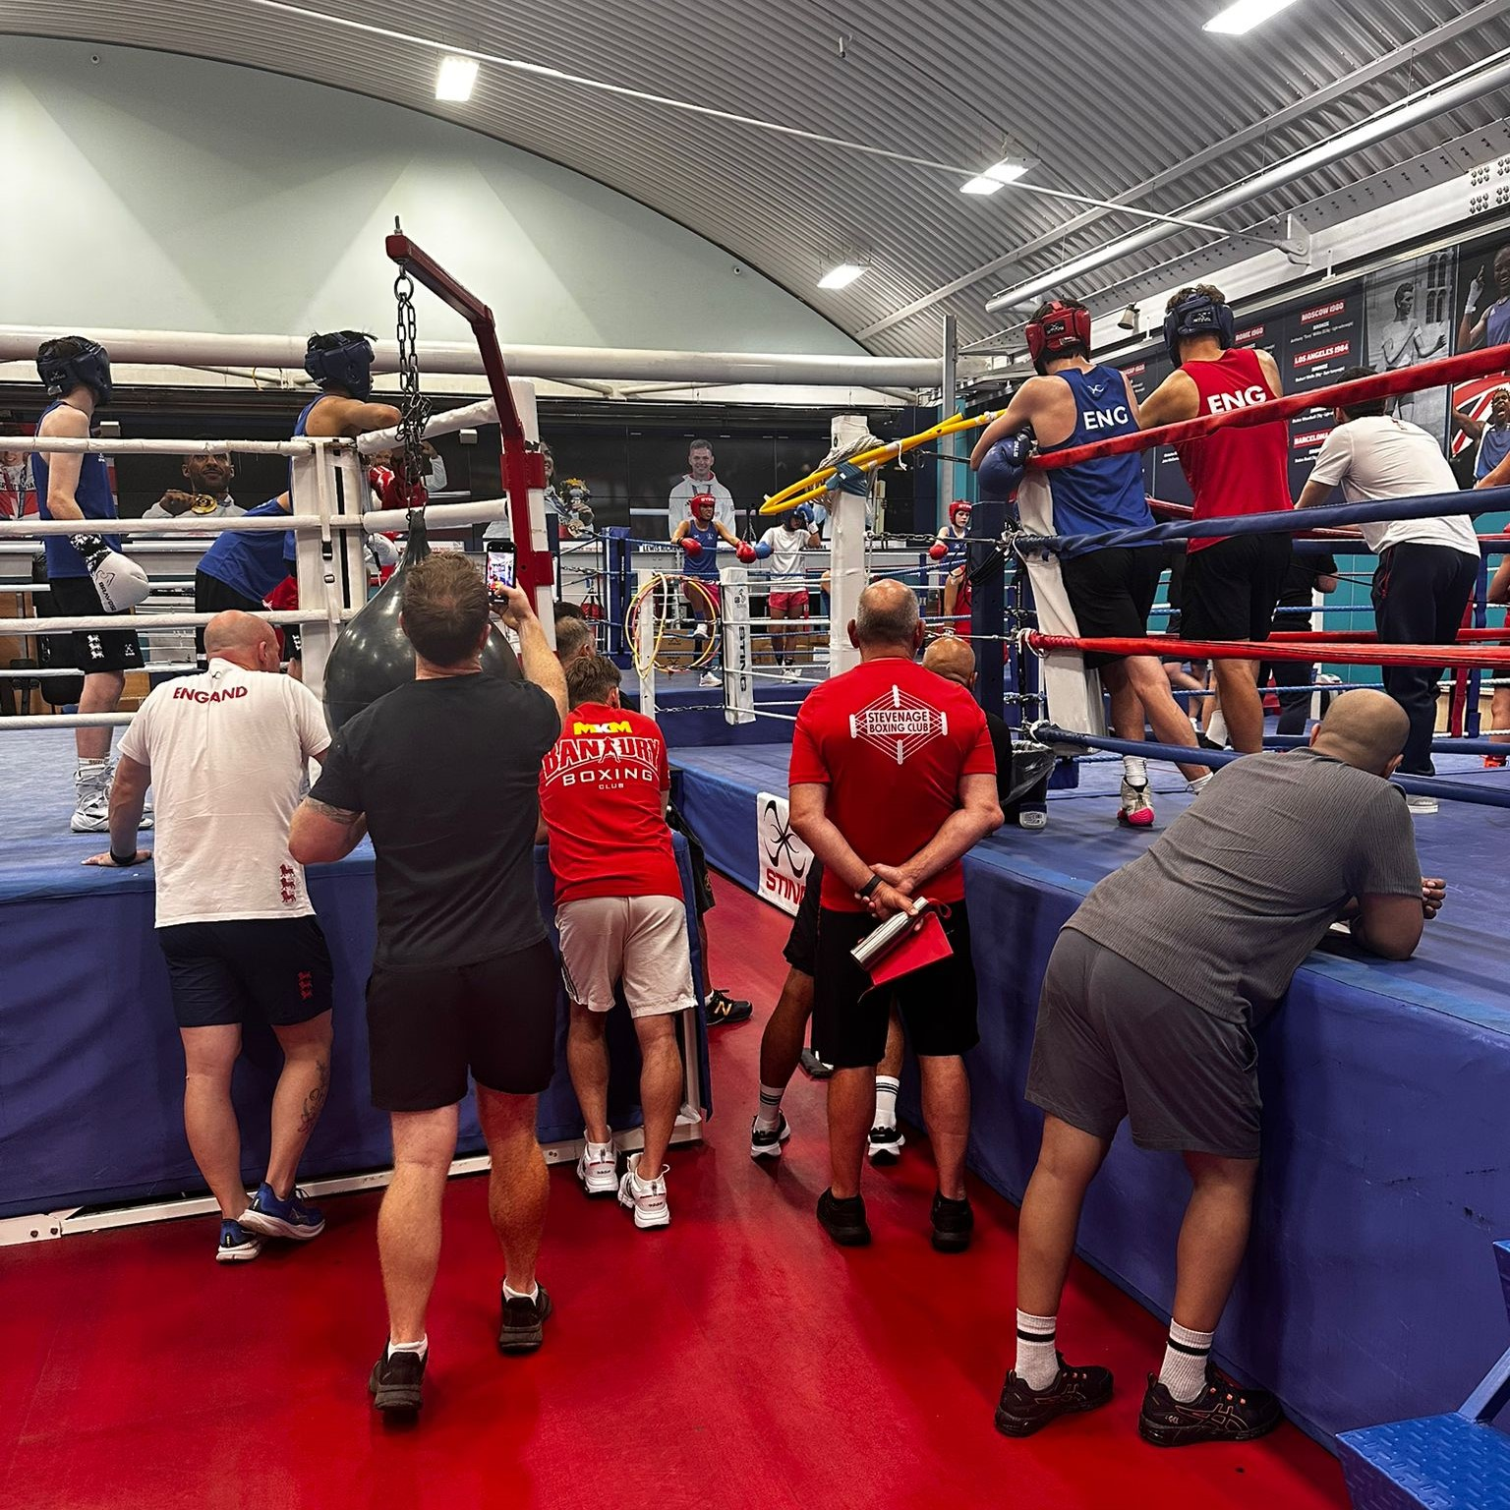
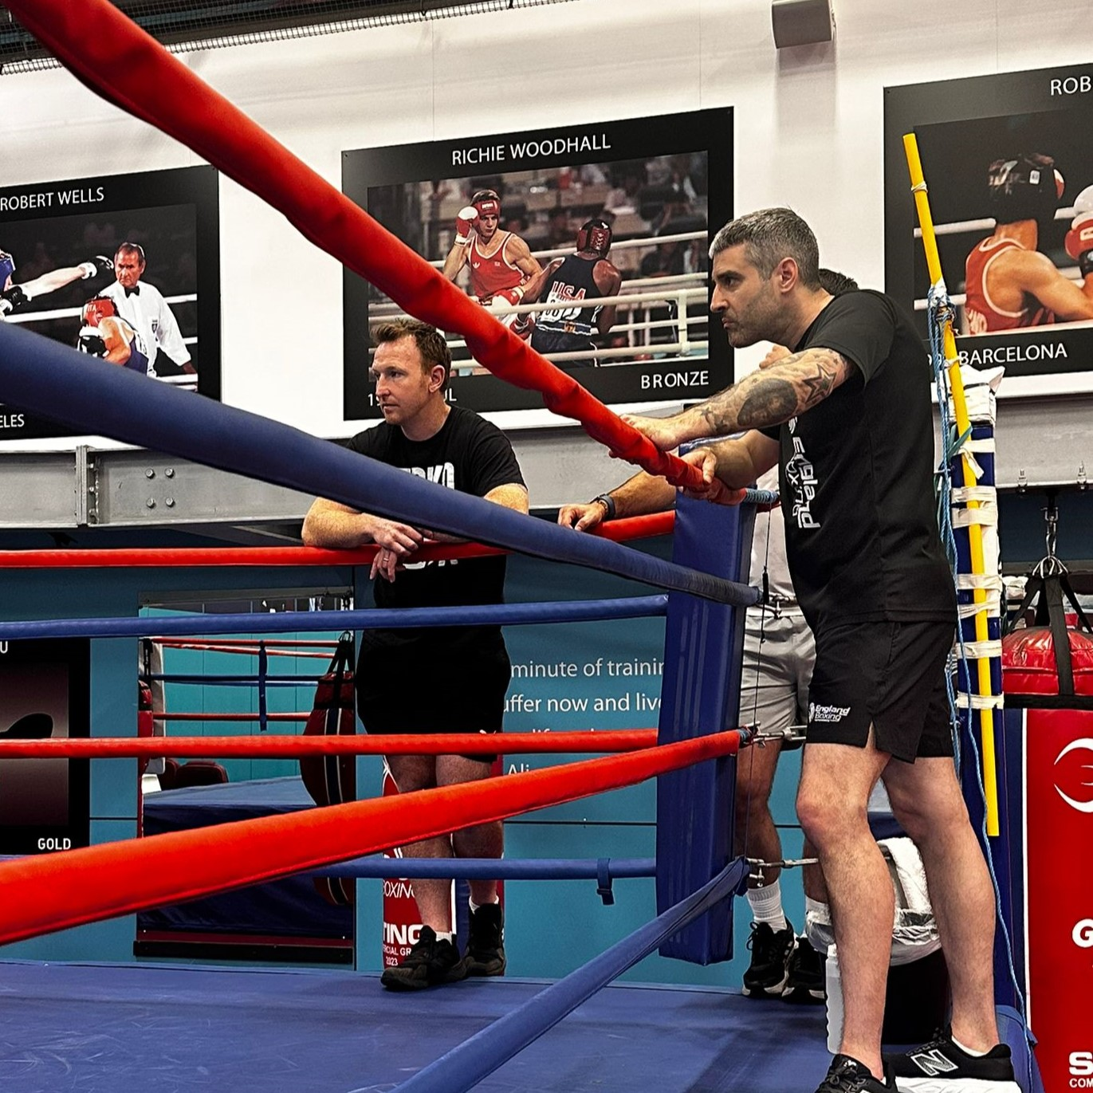
FOLLOWING ON FROM SUCCESS
This opportunity follows the success of the trial phase, which featured ten coaches from the Home Counties. The programme included two intensive residential camps and a one-to-one online development session for each participating coach.
A second camp featured hands-on work with boxers from the Performance Pathway, allowing coaches to apply their learning in a high-performance environment. Central to the project was the exploration and application of the ‘Five Pillars’ coaching framework, abbreviated as BADST: Before, After, Distance, Space, and Tempo.
Coaches on the project demonstrated their understanding by identifying these concepts during video analysis sessions and by applying them in practical sessions with athletes. This framework encompasses the technical and tactical focus of the England Boxing Performance Pathway, providing a consistent language for coaches across the Pathway.
*See end of final slide for more info.

Slide 4
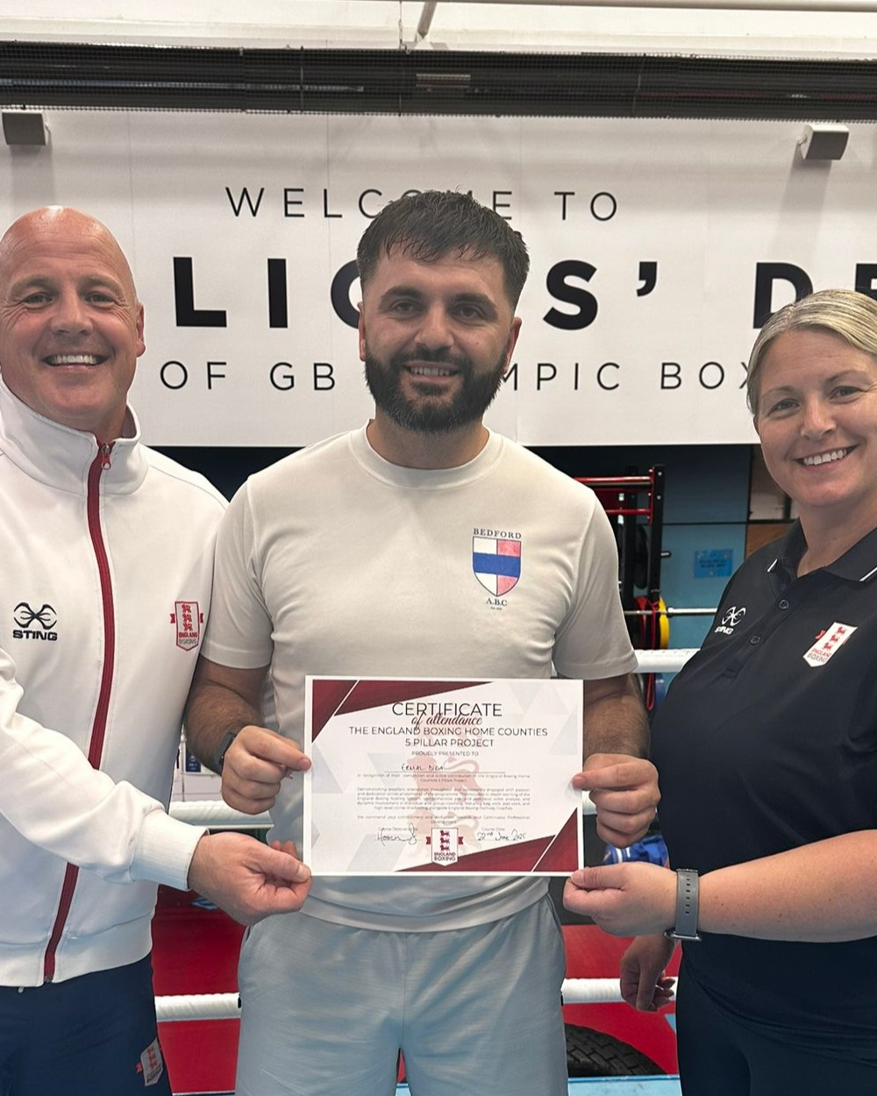
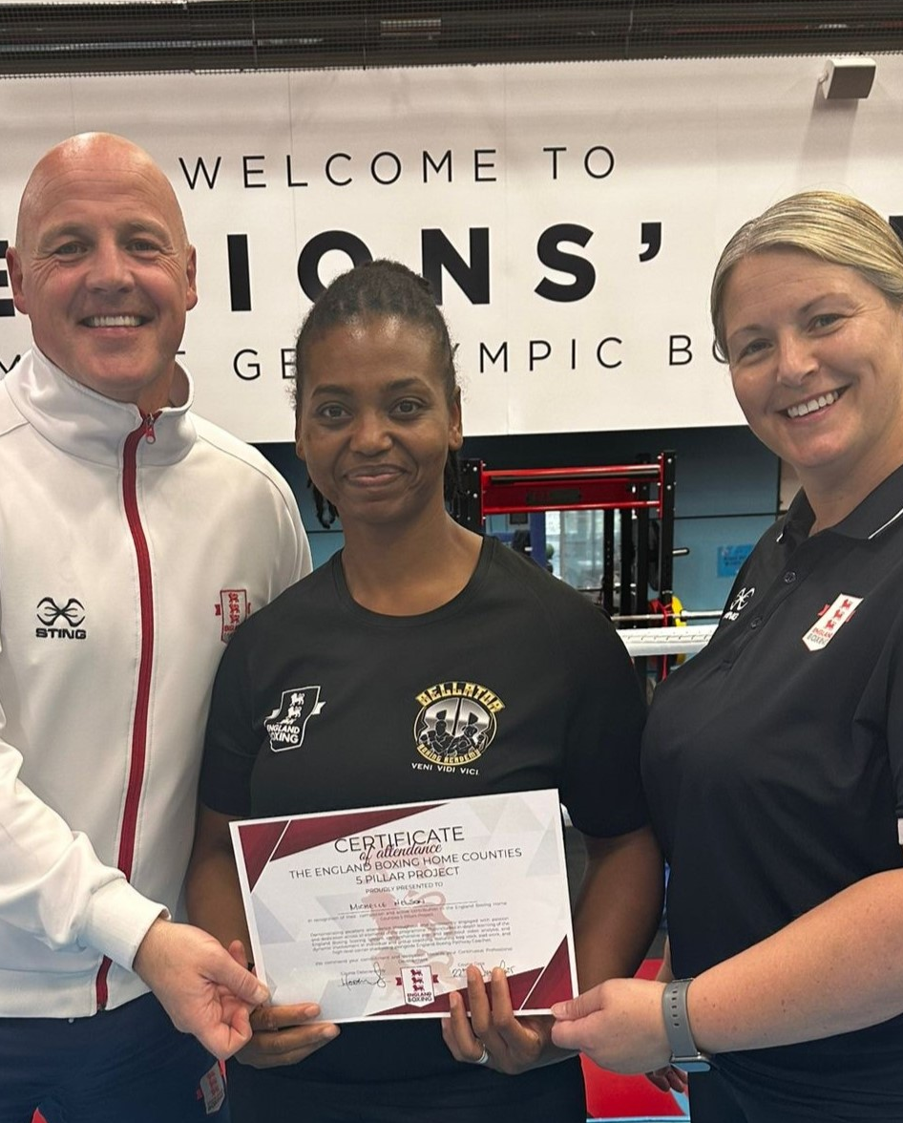
TESTIMONIES
Ermal Dida, Bedford ABC:
“The Five Pillars coaching project has been really beneficial for me. BADST is something we’ve spoken about a lot, and I’ve spent a lot of time implementing it in the gym. It gives our sessions more structure and provides simple, effective steps to help boxers improve. It’s not just useful for me as a coach, but also for the boxers – it’s a boost to help them believe in what they can achieve and how to get there.”
Michelle Nelson, Bellator BA:
“The Five Pillars coaching project has been amazing. We took a deep dive into each element of BADST and got to see it in action with the Pathway boxers. The main thing I’ve taken from it is the confidence to implement the framework at my own club. I now feel like I truly understand it, and that’s helped me pass it on to my boxers effectively. Seeing it used in the residential camps really brought it to life. It’s already become a key part of how we run our training sessions.”
*See end of final slide for more info.

Slide 5
PERSON SPECIFICATION
BEHAVIOURAL:
Conveys an image that is consistent with England Boxing’s values. Demonstrates professional qualities and manner that engender leadership and respect
Believes in and is committed to the vision and strategy of England Boxing.
Demonstrates integrity with a fair, equitable and ethical approach.
Protects confidential information, adheres to England Boxing policies and demonstrates loyalty to the organisation and the team
Ability to work well under pressure, prioritise work and meet deadlines. Can demonstrate flexibility, adaptability and is forward thinking.
Proven leadership and decision-making skills
Appreciation of and commitment to mandatory aspects of child protection, health, safety and welfare in all matters
COACHING:
A broad and deep understanding of Boxing, can demonstrate an understanding of the needs of high-level boxers/coaches
Proven track record in developing domestic or international successful boxers at either school, junior, youth and senior – men or women
Can vary their coaching approach to nurture and consistently develop the very best performances from both male and female boxers across the age ranges
Has clear understanding and experience of long-term athlete development.
Committed to continuous personal improvement
Excellent planning skills
Can set clear, meaningful and measurable targets
Encourages creativity and contribution from others
*See end of final slide for more info.

Slide 6
COACH SPECIFICATION
Southern Counties Coaches only.
Qualifications: England Boxing Level 2 or above
Experience: A minimum of 18 months coaching experience
APPLICATION PROCESS
To apply: Please send a CV and short covering letter (one page) to carl.ellis@englandboxing.org
Application Closing Date: 1st October 2025.

