Slide 1
R&J Core Model and Profile What it takes to be an England Boxing Official Version 2.0

Slide 2
The Core R&J Profile
Mental Focus and Attention
Mindset – it’s about
the boxers…
Professional Judgement
and Decision Making
Working as part of a team and being approachable
Knowing and Understanding the Rules
Willing to learn, taking on feedback and getting better
Quality Observations
Core Values as a person
and role

Slide 3
Mental Focus What is mental focus within the context of being a boxing official? How do you focus your own attention to what is important? What can impact your focus and attention?

Slide 4
Professional Judgement and Decision Making How do you make judgements? What forms your decision-making process? How can bias effective your view? How can you be more consistent with your decision making?

Slide 5
Knowing and Understanding the Rules What is the different between knowing and understanding? The application and interpretation of the rules are essential! How clear are you on the latest updates and changers?

Slide 6
Observations What makes a good observation? What are you looking out for and why? How do you bring objectivity into you observations?

Slide 7
Core Values What are your main values in life? Any different to performing a R&J Role? When and how do you believe your values will be challenged? What happens if someone cross’s your own values? What do you think the boxer values in a R&J?

Slide 8
Willingness to Learn and become better What would make you better? What continuous official development have you done in the past month? How can you use reflective practice within your role to progress and grow? Do you actively seek feedback?

Slide 9
Working as part of a team Reflect upon a world class team away from boxing? What underpins their success? What does a dysfunctional team look like, and why? Leadership, followership and fellowship is essential… how does it relate to your context as a R&J?

Slide 10
Mindset, it’s about the boxers… What do the boxers need from the officials? Boxing is Boxing, however every boxer is different? There is a person within the Boxer (Person, Athlete, Boxer) Your performance and decision making defines a boxers career, think about that for a moment!

Slide 11
Mindful of…..
The Recency Effect
The Primary Effect
Unconscious Biases
Confirmation Bias
Horn Effect
Halo Effect
Reflective Practice

Slide 12
Mindful of….
The recency effect is a cognitive bias that relates to recall of memory. The more recent the memory, the clearer it is. As a R&J (specifically judging), it is essential to recall all observations during the round to make an informed, fair and consistent decision.
The primary effect is a cognitive bias that relates to recall of memory, similar to the recency effect. Primary effect highlights the process whereby the first few observations you make are learnt more rapidity than in the middle. In relation to the R&J roles having clear observations during the whole round is essential. What happens in the middle minute is just as important as the first and the last minute.
Unconscious biases, also known as implicit biases, are the underlying attitudes and stereotypes that people unconsciously attribute to another person or group of people that affect how they understand and engage with a person or group. Remember, as a R&J your role is to judge the performance and make sure the best boxer who performs the best during the bout wins. (Red or Blue!)
Confirmation bias is the tendency to search for, interpret, favour and recall information in a way that confirms or supports one's prior beliefs or values. This relates to justification of decisions. Using facts and aiming to be objective with a clear process helps.
The horn effect, is a form of cognitive bias that causes one’s perception of another to be unduly influenced by a negative trait. As a comment make sense of this, the boxer is alright I just don’t like the way they enter the ring! Be mindful that the role of the R&Js is to observer and judge performance in the ring based on the scoring criteria.
The Halo effect is linked with the horn effect, however the influence of a positive trait can effect one’s observations, judgement and decision making. Factors such as where they are from, who they are coached by, the boxers out of the ring behaviours (he is a nice lad, good family, I really like them). Once again make observations and judgments in the ring and aligned to the scoring criteria. Essential that the best boxer is awarded the win.
Reflective practice is the ability to reflect on one's actions so as to engage in a process of continuous learning. A world class R&J will reflect for action, in action and on action. Therefore, reflection becomes a key part of getting better, progressing and making the most of experiences.

Slide 13
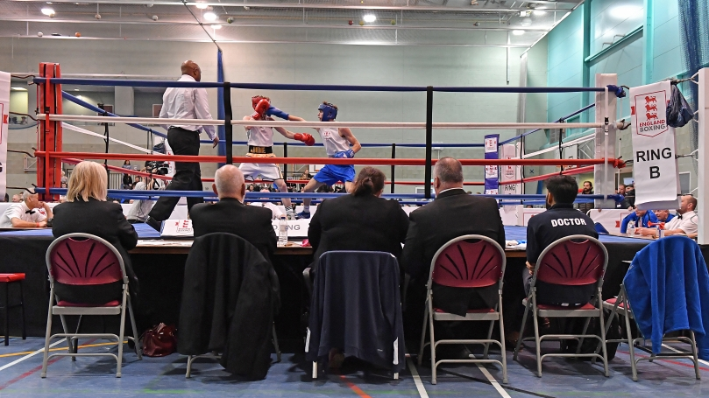
The Core R&J Profile
Mental Focus and Attention
Mindset – it’s about
the boxers…
Professional Judgement
and Decision Making
Working as part of a team and being approachable
Knowing and Understanding the Rules
Willing to learn, taking on feedback and getting better
Quality Observations
Core Values as a person
and role

Slide 14
Acknowledgements Thanks to the following individuals and groups who have supported the development of this core model: Dave Rimmer for the Graphic Design R&J Developer National Development Team The England Boxing Coaching Sub-Committee

Slide 15
Questions?

Slide 16
R&J Core Model and Profile What it takes to be an England Boxing Official Version 2.0

